Slide 1
Image Classification with Deep Learning
Dmitrii Timoshenko

Slide 2
Project Overview
Problem: image classification of different type of sports
Data: obtained from Kaggle. Consists of 110 samples for 100 sport activities
Solutions: pretrained CNN models with various modifications
Results: ResNet50 without any improvements showed the best performance (97% accuracy)

Slide 3
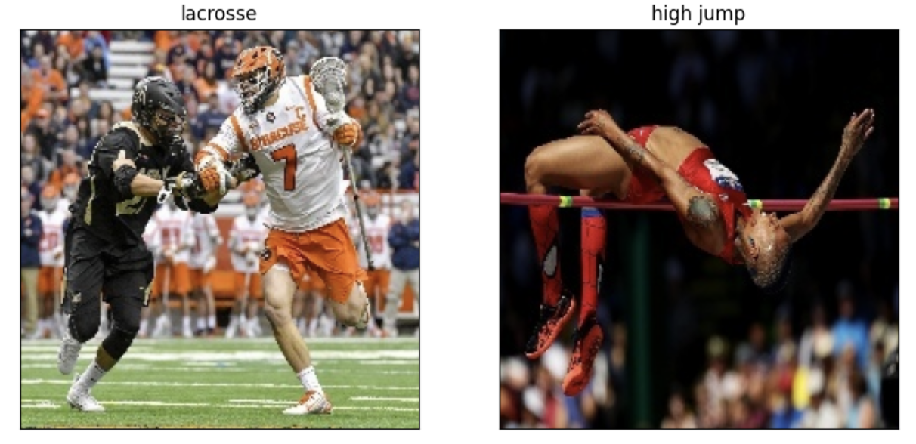
Short Data Overview
Figure 1. Example of sport images

Slide 4
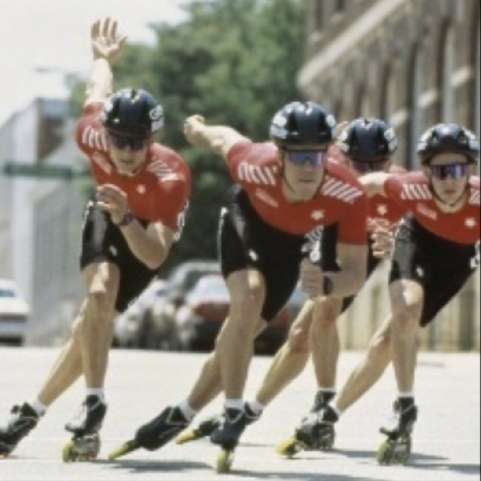
Approach 1: Pretrained CNN
Prediction
Input Image
Frozen layers
Trained classifier

Slide 5
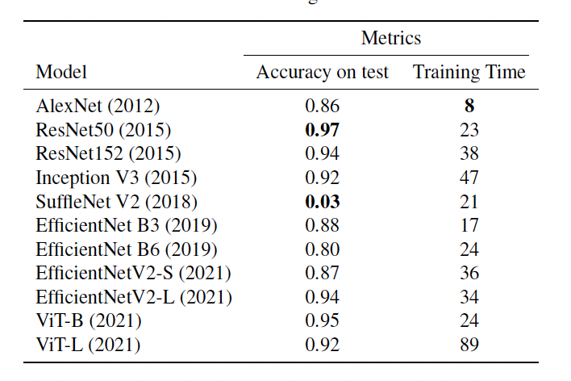
Approach 1: Pretrained CNN
Table 1. Trained different models with frozen CNN part.
Results: ResNet50 demonstrated the best performance

Slide 6
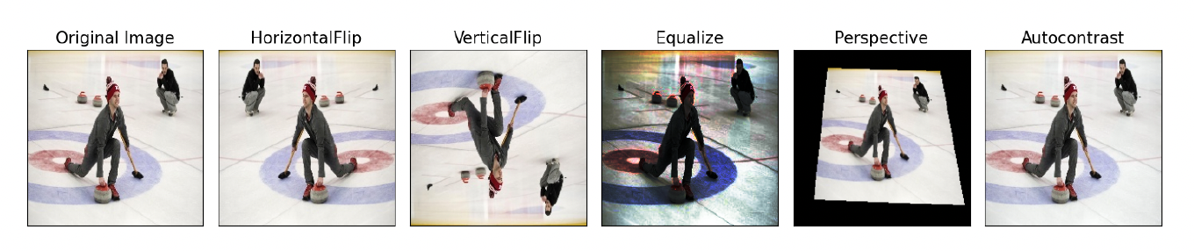
Approach 2: Pretrained CNN with Augmentation

Slide 7
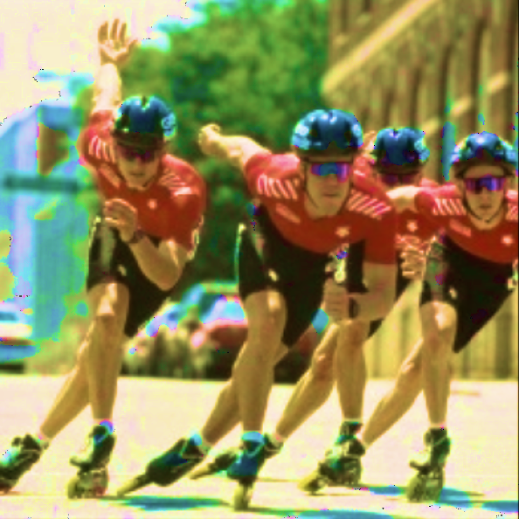
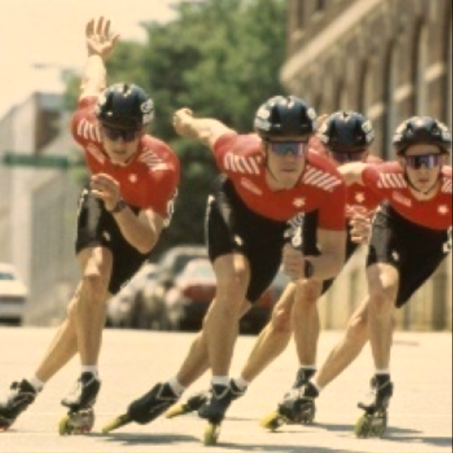
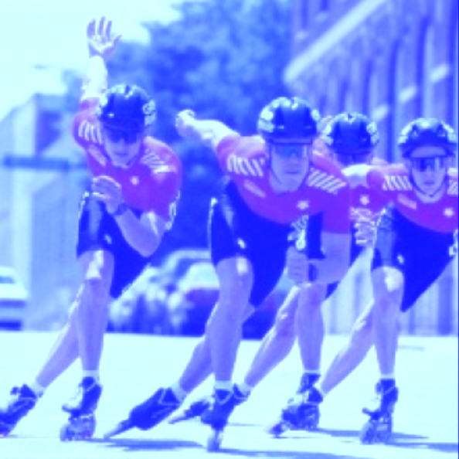
Approach 2: Pretrained CNN with Augmentation
Prediction
Frozen layers
Trained classifier
Input Images

Slide 8
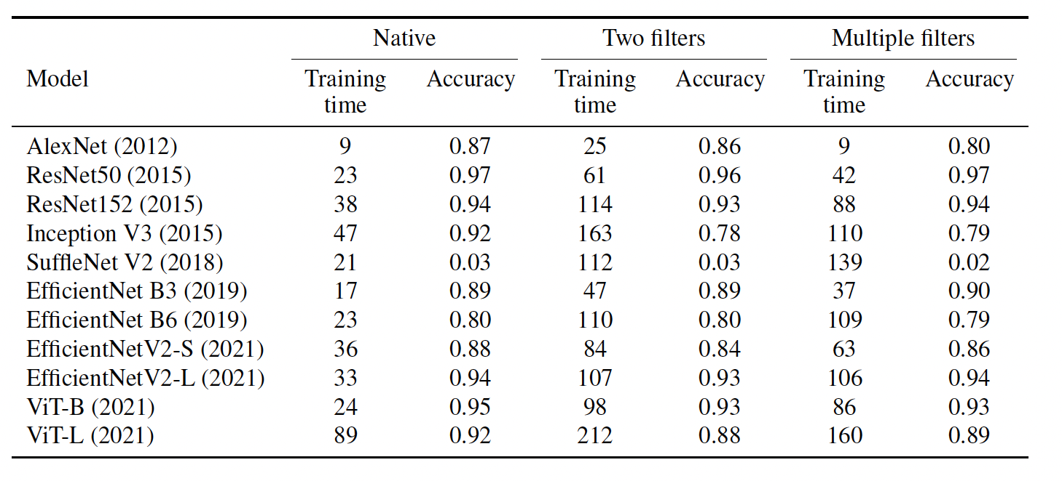
Approach 2: Pretrained CNN with Augmentation

Slide 9
Approach 3: Pretrained CNN with Deep Classifier
. . .
. . .
prediction
ResNet
(feature extraction)
classifier

Slide 10
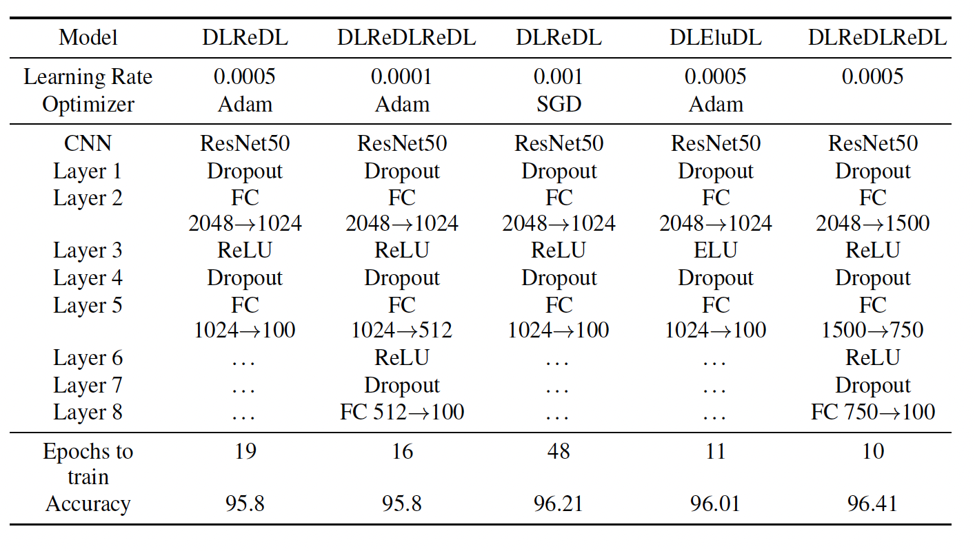
Approach 3: Pretrained CNN with Deep Classifier
Baseline: 97%

Slide 11

Approach 4: Pretrained CNNs with Boosting
. . .
ResNet50
Softmax
(100 features)
. . .
prediction
. . .
AlexNet
Softmax
(100 features)

Slide 12
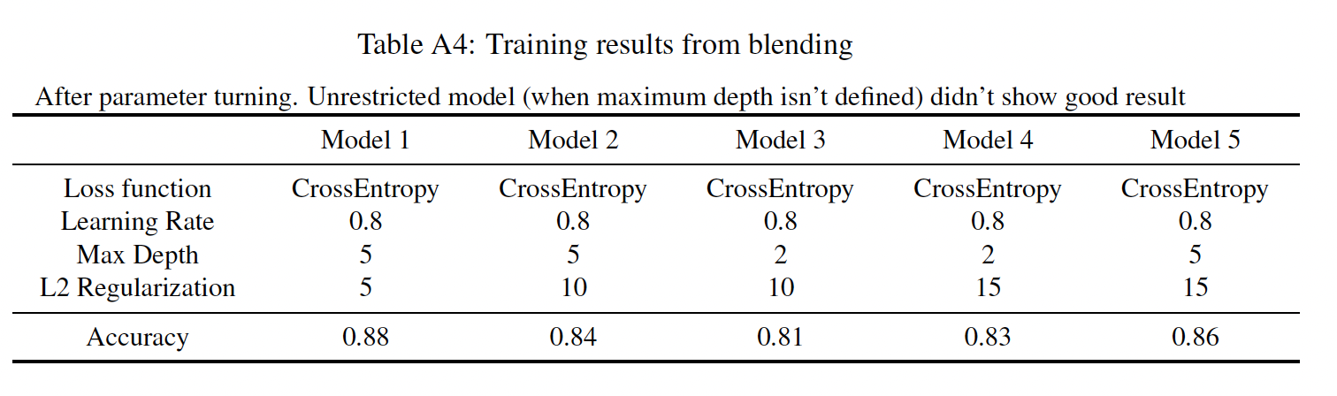
Approach 4: Pretrained CNNs with Boosting
Baseline: 97%

Slide 13
Conclusions
Pretrained ResNet50 demonstrated the best performance across all selected models
Other techniques didn’t show significant improvements
Potential areas to improve:
Train one or two last layers of CNN model
Try another blending techniques
Generate more images with web-parsing

Slide 14
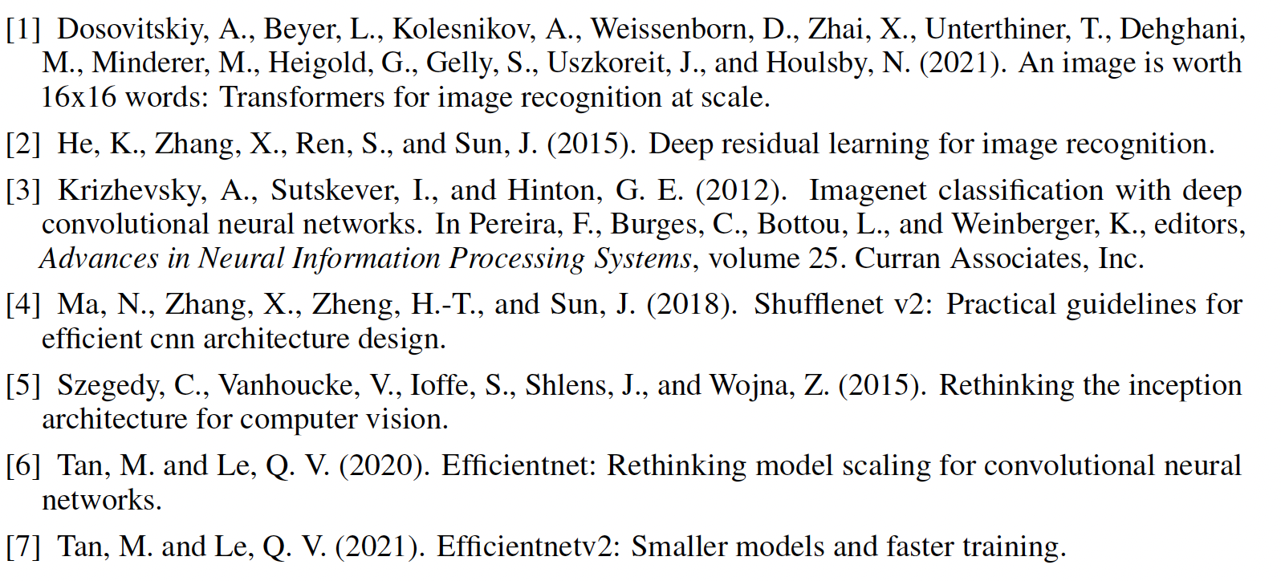
Reference

Slide 15
. . .
. . .
prediction
ResNet
(feature extraction)
classifier

Slide 16
. . .
ResNet50
Softmax
(100 features)
. . .
prediction
. . .
AlexNet
Softmax
(100 features)

